Slide 1

The Symbiotic Relationship between
Configuration Management and Airworthiness
Configuration
Conformity
Design
Limits
Flight Test Safety Workshop San Jose, CA
Mr. Clay Kolb and Dr. Tim Schoppert May 2010

Slide 2

An Incompatible CM and A/W Relationship

Slide 3
Easy to blame the installer, but….
Where else did the holes line up?
NOT HERE…
…but, HERE!
Documentation Agreed
Configuration
Documentation
A/W
Certification
=
Inter-
operability
Conformity
QA
Sound Identification
and Control of the Part
Sound Engineering
Evaluation of the Part
Two out of the three basic verifications had holes that lined up!
The KEY Documents matched, but all verifications did not occur.

Slide 4
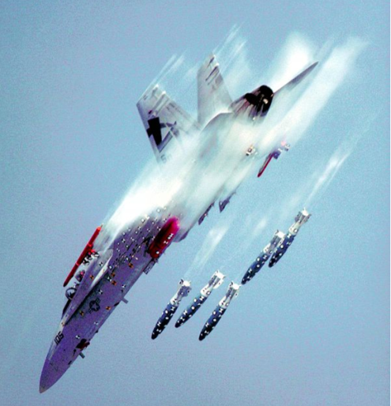
The Flight Test Challenge
With ever-increasing configuration changes due to:
- software-driven aircraft,
- COTS,
prototype designs, and
escalating requirements
Strict continuity between diverse configurations and their A/W certificates is mandatory.
QUESTION:
How can we effectively & efficiently connect constantly changing configurations with applicable Airworthiness certifications?

Slide 5

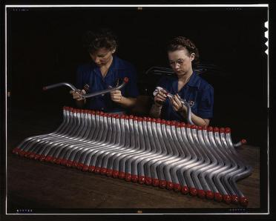
SOLUTION:
Connect your Engineering team to your CM team, and…

Slide 6
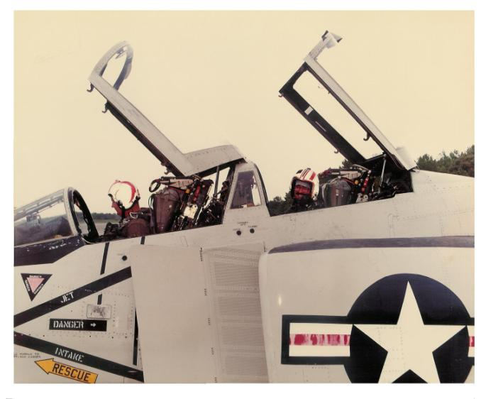
… Strap your testers in with your operators.
Mr. Clay Kolb

Slide 7

Think out of the “Cocoon”
In the flight test world, a modified unit may be UNIQUE and may change configuration many times…
In this world, CM and A/W certification must work together seamlessly, in perfect harmony at all levels: a symbiotic relationship.

Slide 8


Total Workforce Integration
The continual flow of deviations and requirements compel conformity criteria and design definitions to speak with one voice.
The solution must integrate common tools on the most basic of levels.

Slide 9
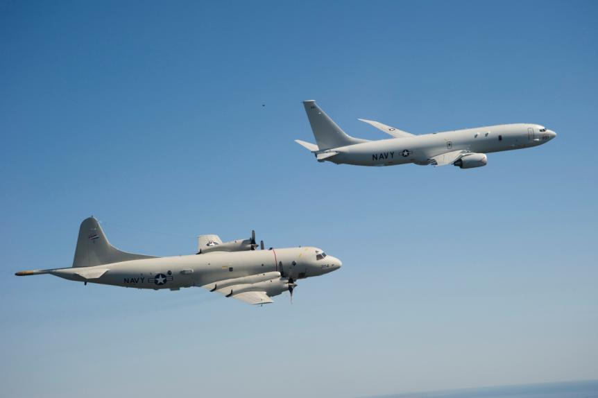
Concept of Operations
Establish a working relationship between Configuration Management and Airworthiness.
  Cross-reference documents
  Cross-check information
  Establish open Communication
Co-locate personnel
  CM and A/W personnel
  Test Pilots and Engineers
Assign roles to check the installation for Interoperability, Conformity, and Quality Assurance.
Establish roles in a check and balance system integration
  Stress independence—Personnel have different roles
  Doers cannot be checkers
  Progression cannot occur without role concurrence
  Everyone has a “no” vote to stop anything at anytime

Slide 10
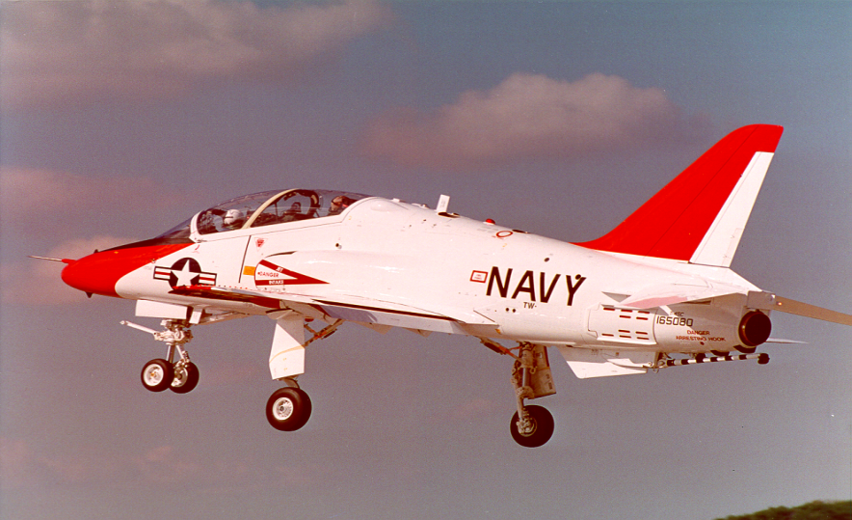
Interoperability
STANDARD ATTITUDE HEADING REFERENCE SYSTEM
APPROACH IDLE STOP
6” FIN CAP
EXTENSION
NEW EJECTION SEATS (NACES)
ON BOARD OXYGEN GENERATING SYSTEM
REDESIGNED GLASS COCKPIT
COMPOSITE STABILIZER
SIMULATED
GUNNERY SYSTEM
HEADS UP DISPLAY
VCR
SMURF
ADD YAW
DAMPER
ADRS
NEW NOSE
STRUCTURE
NEW NLG
NOSE WHEEL STEERING
LAUNCH, HOLD BACK BARS
SASS
F-405-RR-401
ADOUR ENGINE
5845 LBS THRUST
EMI PROTECTION
BACK UP FUEL CONTROL
TAIL HOOK
RELOCATED SPEED BRAKE
CENTRAL VENTRAL FIN
NEW MAIN LANDING
GEAR AND STRUCTURE
IMPROVED BRAKES @3K
ADDITIONAL STRUCTURE
FOR CATAPULT/ARRESTMENT
LEADING EDGE SLATTED WING

Slide 11
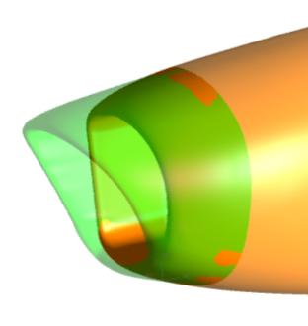
Conformity
Installation
Does installation match design?
Design

Slide 12
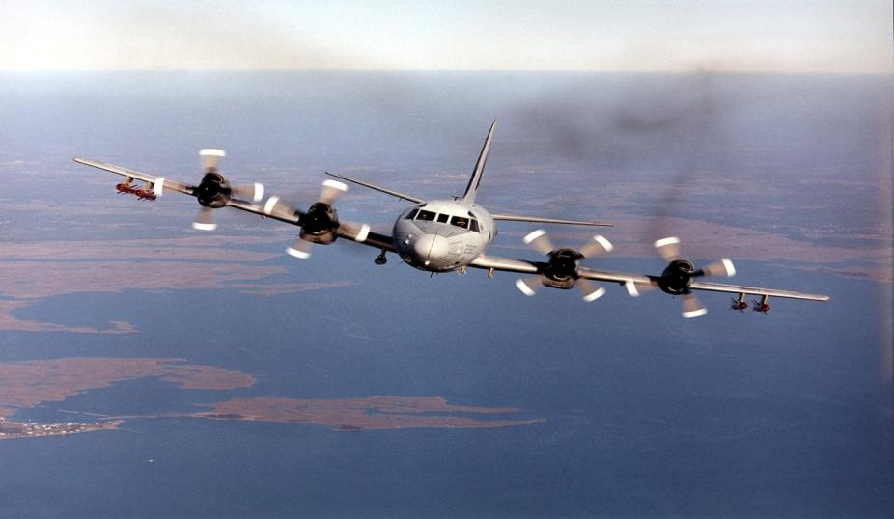
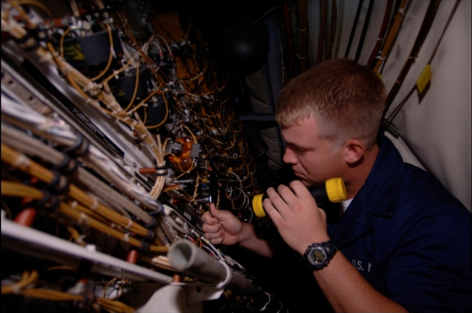
Quality Assurance
Is installation in accordance with practiced standards?

Slide 13

Definition of CM
A formal discipline of program management that integrates and applies technical and administrative actions necessary to:
Identify & Document -- Identify
Validate & Verify -- Audit
Control -- Control
Provide Status Accounting -- Report & Record
the functional and physical characteristics of a product or item throughout its use (or life cycle)
*NAVAIR Aviation Configuration Management Expertise Development (NACMED) course.

Slide 14
Definition of AW
The property of an aircraft system configuration to safely attain, sustain, and terminate flight in accordance with approved usage limits. The Airworthiness Process also applies technical and administrative actions necessary to :
Identify & Document -- Identify
Provide engineering assessment -- Assess
Control -- Control
Provide Final Sign Out and record -- Report & Record
of the aircraft system configuration to be considered certified safe for flight within approved usage limits.
*Permanent approvals are provided by the NATOPS and NATIP manuals

Slide 15


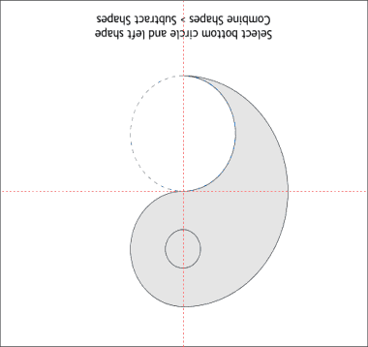





Link up Definitions,
and Assign Roles
Flight Test
Safety
CM
AW
Identify
Identify
Communication
Audit
Assessment
Communication
Control
Communication
Control
Report
Communication
Record

Slide 16

Identify
Early identification of requirements and data
Configuration Management
Airworthiness Management
Platform Specific Expert:
  Identifies Configuration Change requirement
  Identifies interoperability of changes
  Coordinates with A/W office on data
Flight Clearance Release Authority:
  Identifies Interim Flight Clearance requirement
  Integrates interoperability of changes with Platform Specific Expert
  Coordinates with platform experts on data

Slide 17
Audit & Assess
Determination of Independent Assessments
Configuration Management
Airworthiness Management
Modification Coordinator
Determines inspector review requirements
Sets criteria for “complete” review and installation of modification
Flight Clearance Release Authority
Determines engineer review requirements
Sets criteria for “complete” review and issuance of IFC

Slide 18




Audit & Assess
Execution of Independent Assessments
Configuration Management
Airworthiness Management
Inspectors
Audit installation for:
  Conformity to Mod Package
  Conformity to A/W description
  Quality Assurance
Technical Area Experts
Assess engineering of design for:
  Engineering logic
  Conformity to Navy standards

Slide 19


Control
Acceptance of Work Done; Final Control Checkpoint
Configuration Management
Airworthiness Management
Modification Coordinator
Final QA on installation
  All work is done
  All inspections complete
  Update Mod package (if required)
  Final check on conformity
  Final Signature on Installation
Flight Clearance Release Authority
Final QA on A/W Certificate
  All requirements coordinated
  All TAEs are satisfied
  Update Mod references (if required)
  Final check on design review
  Final Signature on Certificate

Slide 20

Report & Record
Logs and Records updated; Requirements met
Configuration Management
Airworthiness Management
Test Squadron Maintenance
Accepts Aircraft back in workflow
Updates Aircraft Discrepancy Book with new A/W Certificate
Releases Aircraft for flight
Flight Clearance Release Authority
Officially issues A/W Certificate
Updates database with new A/W Certificate and related information
Records Aircraft change safe for flight

Slide 21



Future CM Software called NAVPASS
Naval Aviation Project Activity Support System
Configuration Management
Airworthiness
Mod Requests
Inducted with
Web Page
Common input
Template
Common input
Template
IFC Requests
Inducted with
Web Page
NAVPASS
T/M/S Lead at Squadron
is first chop
T/M/S Lead at HQ
is first chop
CM Officer
Inputs/builds folder
A/W Facilitator
Inputs/builds folder
CM Officer
Picks Inspector SMEs
A/W Officer Picks
Engineering TAEs
Mod auth
Signs out final
A/W auth
Signs out final
Access to same
Database

Slide 22
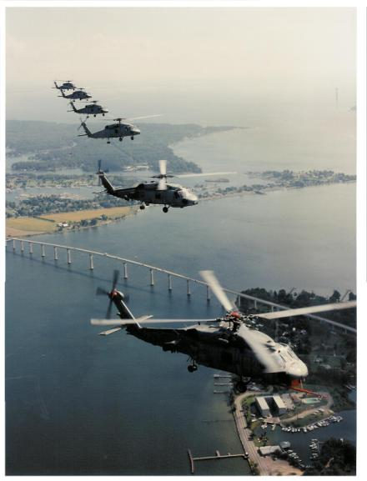
Does this Really Work?
Stats: In 2009 we;
Performed 2,784 Modifications, and
Obtained 1,890 A/W Certifications
Without Incident.
Adherence to Policy and Streamlined Processes can Coexist.

Slide 23

To Recap…
Link Configuration Management and Airworthiness at common levels to work in unison on:
  Configuration descriptions,
  Independent reviews,
  Interoperability analysis,
  Conformity reviews, and
  Quality Assurance of the installation
Empower personnel to communicate requirements at common levels and encourage continual communication.
Require independent reviews (doers cannot be checkers).
Recognize that legacy aircraft can still have severe Configuration Management and Airworthiness issues when new or multiple projects are installed and operated on them.

Slide 24
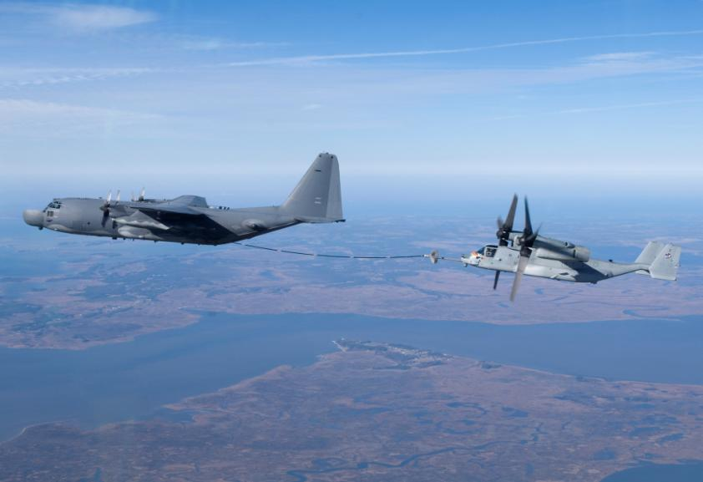
And finally…
Don’t become complacent
Even when everything is done correctly, and all process/procedures are followed, there can still be problems
There are unknown unknowns
When things go wrong in this environment, they go:
  REAL WRONG
  REAL QUICK

Slide 25
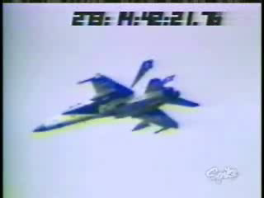

Slide 26

QUESTIONS?

